Slide 1
Understanding the link between developmental plasticity and evolvability
using the theory of memory, learning and generalisation
aka, ontogentic lability
Richard Watson, Loizos Kounios, Kostas Kouvaris J Clune, GP Wagner, DM Weinreich, M Brede, M Pavlicev, R Mills
Institute for Life Sciences/ Institute for Complex Systems Simulation,
University of Southampton, UK.
raw@ecs.soton.ac.uk
Notes:
Please use the dd month yyyy format for the date for example 11 January 2008. The main title can be one or two lines long.

Slide 2
Phenotypic distributions and Evolvability
The path of evolutionary trajectories and the possibility of biological adaptation is strongly affected by historical contingencies – developmental biases and constraints accumulated over the evolutionary past
One phenotypic distribution may afford adaptation in some environment where another does not - and phenotypic distributions are controlled by the details of developmental process which are themselves evolved
Thus, via developmental biases and constraints, past evolution could adapt the distribution of phenotypes explored by future natural selection to generate more promising variations and avoid less useful ones – predisposed to exhibit effective adaptation

Slide 3
Foresight and the Paradox of Evolvability
How could long-term evolvability be favoured by natural selection given
a) evolution has no foresight selection cannot favour traits that are beneficial in as-yet-unrealised future environments?
b) conflict of robustness vs evolvability short-term selective pressures seem more likely to favour robustness than variability?
(want an explanation that does not depend on a higher-level evolutionary process)

Slide 4
Learning theory meets evolvability
Could learning theory help us understand how evolution could (act like) it anticipates whats needed in novel selective environments – the evolution of evolvability?
In learning systems, generalisation from training set to previously unseen novel test cases is neither mysterious nor for granted
If generalisation in learning only requires incrementally improving the fit of a model to data – maybe evolution could do that in a non-mysterious way – and we could use what we know about conditions for good generalisation to understand conditions for evolution of evolvability

Slide 5
What kind of bias/constraint could development place on phenotypic distributions?

Slide 6
How do offspring differ from parents?
Default: Undirected genetic variation -> undirected phenotypic variation
How much?
Trait y
Trait x
Given the option, selection nearly always turns off variation (J. Clune et al., PRSB, 2013)

Slide 7
Uniform genetic variation –> non-uniform phenotypic variation
E.g. More variation on some dimensions, less on other dimensions
As before, selection turns off variation on as many dimensions as its allowed to

Slide 8
Patterns of phenotypic variation (rather than amounts)?
E.g. phenotypic correlations

Slide 9
Pavlicev, M., Cheverud, J. M., & Wagner, G. P. (2011). Evolution of adaptive phenotypic variation patterns by direct selection for evolvability. PRSB, 278(1713), 1903-1912.
Evolution of a modifier locus that alters the correlation between two other traits
Selection aligns variation with the direction of selection
variation that is directed wrt fitness effects
Goes uphill faster – does what its already doing faster – not really any new phenotypes

Slide 10
Pavlicev, M., Cheverud, J. M., & Wagner, G. P. (2011). Evolution of adaptive phenotypic variation patterns by direct selection for evolvability. PRSB, 278(1713), 1903-1912.
Evolution of a modifier locus that alters the correlation between two other traits
Selection aligns variation with the direction of selection
variation that is directed wrt fitness effects
Goes uphill faster – does what its already doing faster – not really any new phenotypes

Slide 11
a linear model
Feed-forward gene-network
Value of X is sensitive to context of y
Value of Y is sensitive to context of x
genes
traits
x
Wxx
X
genetic inheritance
input
Wxy
Phenotype
output
y
Wyx
Y
Wyy
Pleiotropic interaction matrix

Slide 12
linear correlation models cant do multi-modal distributions
Non-linear mappings can
producing two different phenotypes that differ in many traits ‘simultaneously’. e.g. produces petals and sepals but not mixtures in between

Slide 13
Non-linear model
Recurrent gene-regulation network (GRN)
Value of x(t+1)is sensitive to context of y(t)
Wxx
Value of y(t+1) is sensitive to context of x(t)
x
Embryonic phenotype (t=0)
Wxy
Adult Phenotype
(t=10)
y
Wyx
Wyy
Gene-regulation interaction matrix
initial gene expression levels unfold over time into adult gene expression levels
We will evolve the connection matrix

Slide 14
Outline
1. Can evolution of constraints and biases cause development to be predisposed to recreate multiple distinct phenotypes that have been selected for in the past?
2. Can it generate novel phenotypes from the same structural class – e.g. new combinations of features?
3. Can it use this to evolve better… to generate novel phenotypes that are more likely to be fit → facilitated variation
memory
generalisation
learning

Slide 15
1: memory
Watson, R. A., Wagner, G. P., Pavlicev, M., Weinreich, D. M., & Mills, R. (2014). The evolution of phenotypic correlations and ‘developmental memory’. Evolution.
a single GRN can be ‘programmed’ by past selection to ‘remember’ multiple phenotypes

Slide 16
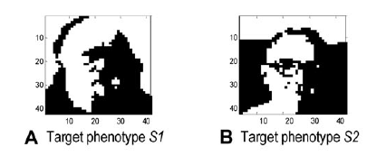
Two different phenotypes (gene expression patterns) selected for in different environments
Selecting for regulatory connections that output the selected phenotype pattern

Slide 17
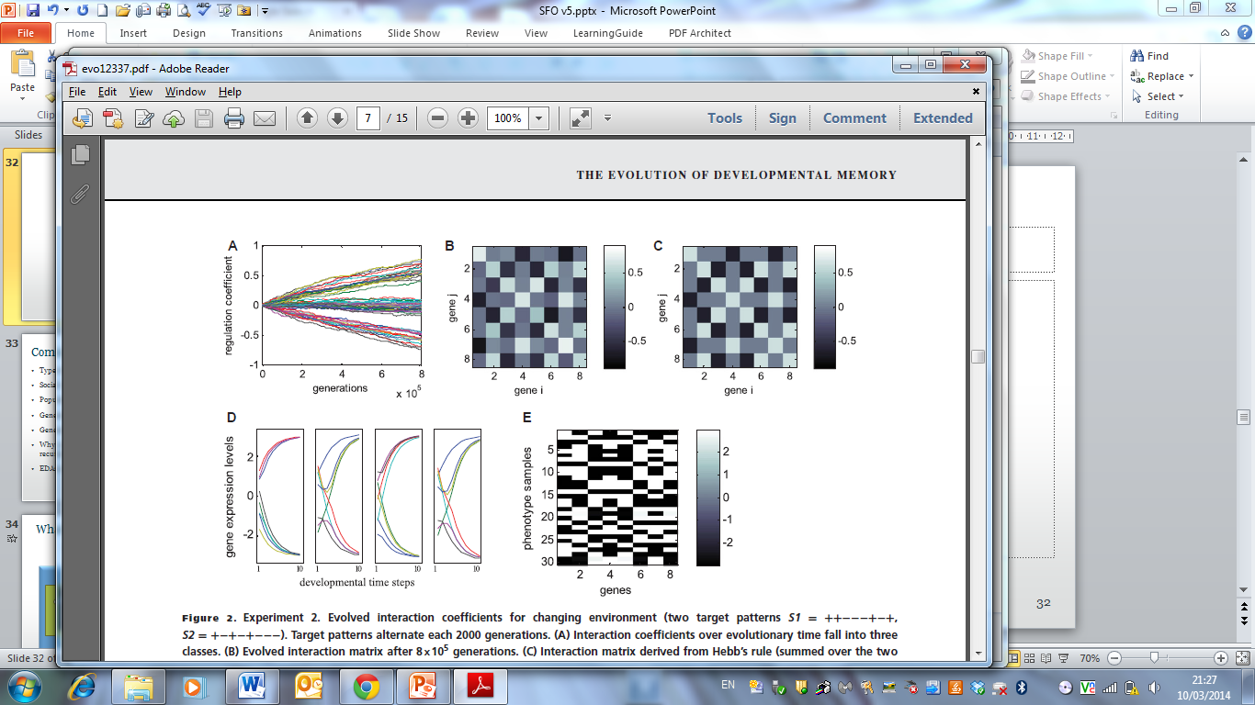
Two different phenotypes (gene expression patterns) selected for in different environments
Selecting for regulatory connections that output the selected phenotype pattern
Evolved regulatory interactions accurately capture trait correlations in selected phenotypes
gene-regulatory interaction strengths change over evolutionary time
evolved regulation matrix

Slide 18
Two different phenotypes (gene expression patterns) selected for in different environments
Selecting for regulatory connections that output the selected phenotype pattern
Evolved regulatory interactions accurately capture trait correlations in selected phenotypes
gene-regulatory interaction strengths change over evolutionary time
matrix learned with Hebbian learning from same two phenotype patterns
evolved regulation matrix
Genes that are selected together wire together

Slide 19
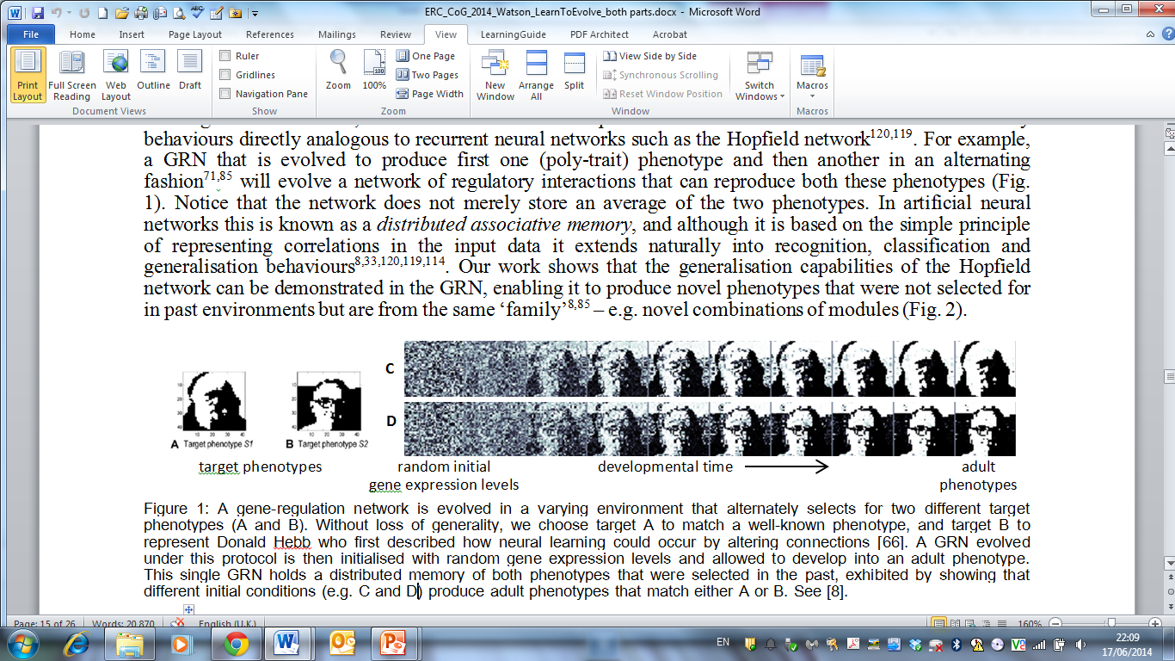
Produces developmental memories:
Evolved regulatory interactions create developmental attractors that correspond to previously selected phenotypes
Single gene network can remember more than one phenotype. G-P map literally is a memory of solutions to past selective environments.

Slide 20
Produces developmental memories:
Evolved regulatory interactions create developmental attractors that correspond to previously selected phenotypes
Single gene network can remember more than one phenotype. G-P map literally is a memory of solutions to past selective environments.

Slide 21
Produces developmental memories:
Evolved regulatory interactions create developmental attractors that correspond to previously selected phenotypes
Single gene network can remember more than one phenotype. G-P map literally is a memory of solutions to past selective environments.

Slide 22
Produces developmental memories:
Evolved regulatory interactions create developmental attractors that correspond to previously selected phenotypes
Single gene network can remember more than one phenotype. G-P map literally is a memory of solutions to past selective environments.

Slide 23
2. generalisation.
Kostas Kouvaris
Can an evolved GRN produce phenotypes that were not selected for in the past?
But are structurally similar to phenotypes that were selected in the past
E.g. learn what ‘well formed features’ look like, and then make new combinations of these features

Slide 25
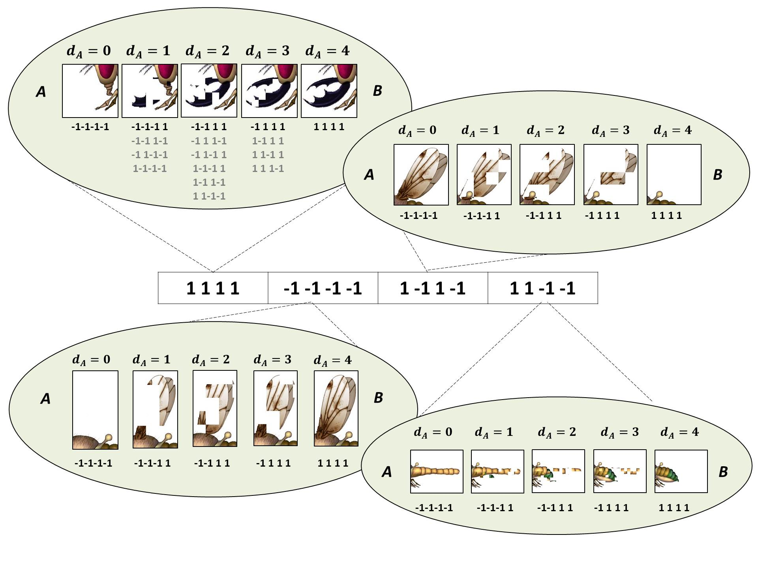
Pictorialisation: 4 features, each controlled with 4 gene levels

Slide 26
All combinations of well-formed features

Slide 27
Select for 3 particular combinations of well-formed features

Slide 28
Evolved GRN produces…
the 3 selected phenotypes, plus some other combinations of well-formed features, but not all 16

Slide 29
Regulation that controls correlations…
Also produces complementary phenotypes w all the same correlations
Not an interesting sense of generalisation

Slide 30
Regulation that controls correlations…
Also produces complementary phenotypes w all the same correlations
Not an interesting sense of generalisation

Slide 31
failure to generalise: Overfitting
In machine learning the tendency to learn the specific patterns that were rewarded in the past, but to fail to learn the general class of patterns, is known as overfitting.
In learning models, we know something about conditions that alleviate overfitting – e.g. when there is a parsimony pressure for simple/compact models.
A cheap and easy way to do this is to favour networks that learn the training patterns using less connections – encourages GRN to learn the main structural relationships of the class without simply memorising the specifics of the training set.

Slide 32
GRN evolved with costly connections
produces all combinations of well-formed features

Slide 33
3. From phenotypic plasticity to evolvability
Loizos Kounios
If an evolved GRN can be predisposed to produce novel combinations of features …
Are there conditions where that ability will bias evolutionary trajectories in useful ways – to facilitate adaptation?
Wagner already showed it can evolve same phenotypes faster – likewise Uri Alon. And Alon showed some generalisation…so can can that generalisation enable evolution of new fitter phenotypes?

Slide 34
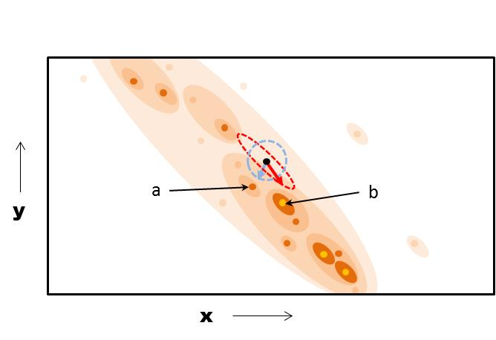

Slide 35
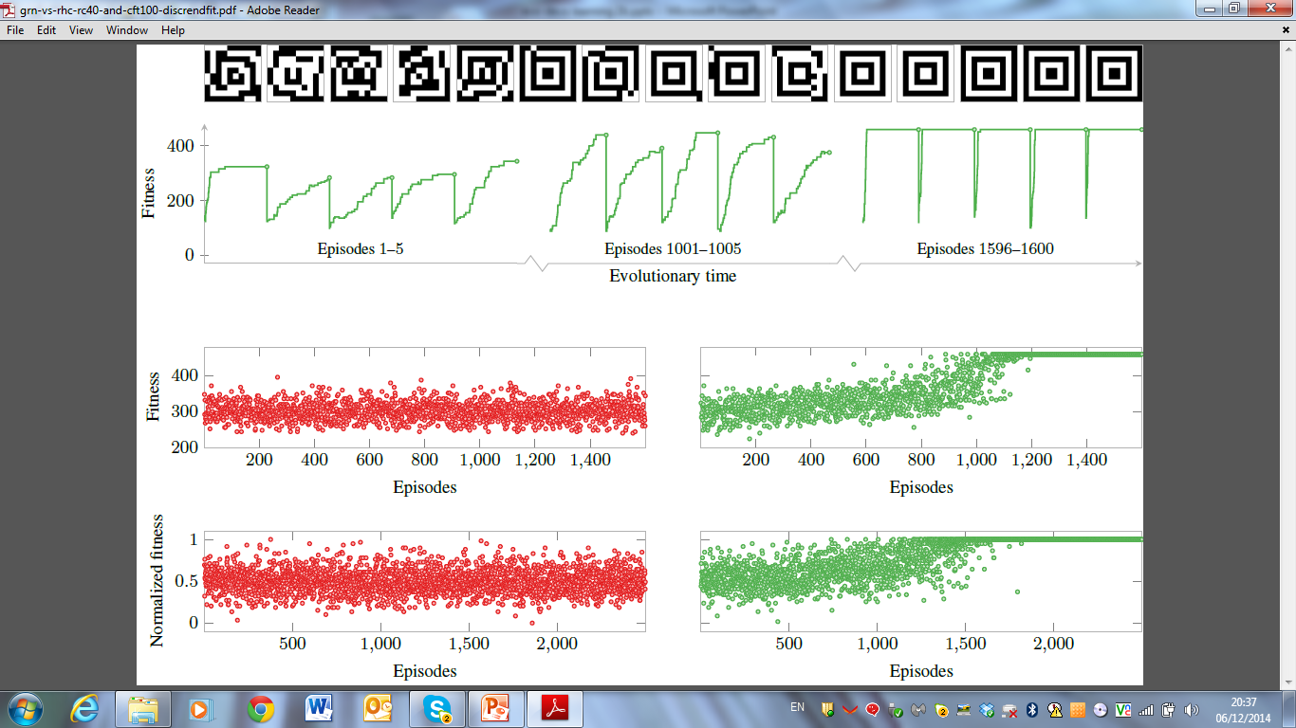
Test case
‘Target’ phenotype
10x10 image = 100 genes
Lots of sign-epistasis → a fitness landscape with many local optima (where local regions of the phenotype agree with the image).

Slide 36
A micro-evolutionary trajectory using original GRN (i.e. a 1:1 G-P map) finds locally optimal phenotype

Slide 37
Micro-evolutionary trajectories starting from different points find different locally optimal phenotypes

Slide 38
Each phenotype found is a ‘training pattern’ to the evolving GRN. It cant remember all of them – but it can remember what’s common to them – underlying structural regularities

Slide 39
As GRN evolves, it biases evolutionary trajectories to recreate those regularities

Slide 40
Eventually, evolved GRN causes evolution to find a maximally fit phenotype every time

Slide 41
memory facilitates adaptation
Fitness at end of each episode
Evolutionary time (episodes)
Because it doesn’t just recreate the past, it creates generalisations of it

Slide 42
summary
1. Evolution of constraints and biases can cause development to recreate multiple (significantly distinct) phenotypes that have been selected for in the past
2. …and generate novel phenotypes – not selected in the past, but from the same structural class – e.g. new combinations of features
3. …and learn how to evolve faster and better… how to generate novel phenotypes that are more likely to be fit, or lead to fit phenotypes → facilitated variation
memory
generalisation
learning

Slide 43
Resolving paradox of evolvability
Evolution of phenotypic distributions well-suited to future environments (via myopic process of ENS in past environments)…
…is no more mysterious than generalisation to an unseen test set from a limited training set
Its not mysterious, (inductive learning is not impossible)
but its not for granted either - we understand the conditions where it works/fails.
And we can use that to understand the conditions for the evolution of evolvability

Slide 44
Thanks to
Louis Kounios
Kostas Kouvaris
Gunter Wagner
Rob Mills
Chris Buckley
Eörs Szathmáry
Daniel Weinreich
Michaela Pavlicev

Slide 46
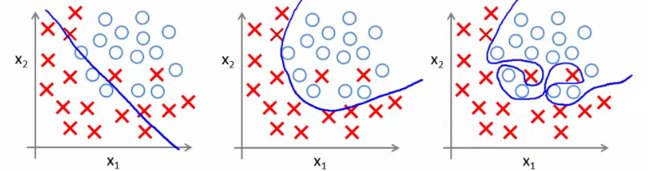
Failure to generalise: overfitting problem
Model is too simple
(underfitting)
Good fit to training data
And good generalisation
Overly complex model
(overfitting)
Getting good performance on training set but failing to generalise to test set

Slide 47
Good evolvability = avoiding overfitting
The difficulty of evolving evolvability is analogous to overfitting – getting phenotypic distributions that are well suited to novel selective environments (not canalised to past selective environments)
Getting good performance on the training set is the easy part of learning, the difficult part is getting good performance on the test set ➔ evolution is much easier than evolution of evolvability

Slide 48
The simplistic analogy
Evolution and learning are both types of adaptation
Evolution is a process of incremental improvement, trial and error, random variation and selective retention in a population
Trial and error is also a simple type of learning, random variation and selective retention in a brain (entertaining a ‘population’ of ideas/hypotheses in your head)
Both can be seen as mechanisms of improving the fit of an individual or a behaviour to an environment (on different timescales)

Slide 49
Basics of a formal analogy (for simplistic cases)
Evolution | learning
a genotype in a population | a hypothesis/belief about the world
the proportions of genotypes in a population | relative confidences in truth of those hypotheses
change in frequency of a genotype under natural selection in an environment | change in confidence in a hypothesis given evidence

Slide 50
Extending the scope of the analogy
Could smarter types of learning models be useful for understanding problematic areas of evolutionary theory?
Feedbacks between an adaptive process, its task environment and internal model are very well characterised in machine learning
Can this be used to characterise biological feedbacks between
Interaction of evolution and development
Interaction of evolution and ecology
Interaction of selection on existing evolutionary units and evolution of new evolutionary units

Slide 51
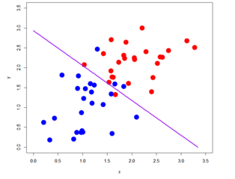
generalisation

Slide 52
generalisation
Linear combination model: ((x/3.5)+(y/3.0) > 1 ) → RED

Slide 53
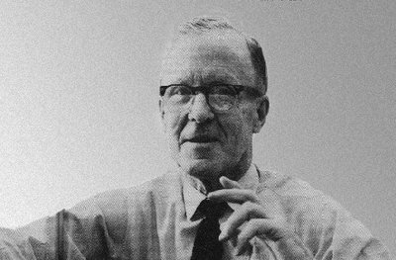
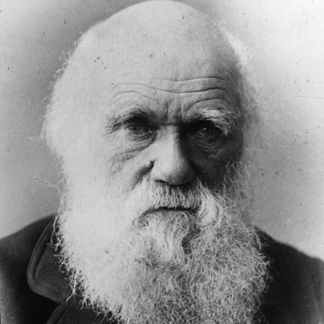
Learning /Evolution
Donald Hebb
isomorphism
learning rules to exploit correlations
≡
selective pressures on evolved correlations
?
(Watson et al, 2010, 2011a,b, 2012 – Artificial Life, Adaptive Behaviour, Complexity, Evolution)
learning/memory, generalisation, categorical perception/recognition constraint optimisation
learning/memory, generalisation, categorical perception/recognition and constraint optimisation

Slide 54
Predictions from associative learning
neural networks | gene networks
1. Neurons that fire together wire together. | genes that are selected together wire together.
2. Distributed associative memory. (i.e. ability to store patterns of activation in the organisation of synaptic connections and recall patterns via activation dynamics) | Ability to store multiple past phenotypes in the organisation of interactions between genes and recall these states via gene expression dynamics.
3. Recall of a stored pattern from a partial stimulus. | Recreating a full phenotypic pattern from partially similar embryonic conditions.
4. Recognition or categorical perception of an input. | Switch-like phenotypic response to incremental changes in genetic input.
Watson, R. A., et al. (2014).. Evolution.

Slide 55
Adv. predictions from associative learning
neural networks | gene networks
5. Generalisation: generate patterns that are novel but from the same class (not nec. adjacent in feature space) | Development pre-disposed to produce phenotypes that are novel but from the same class as phenotypes selected in the past (not neighbours in trait space)
6. Improve constraint solving ability with experience | Evolve faster and find fitter phenotypes more reliably over evolutionary time

Slide 56
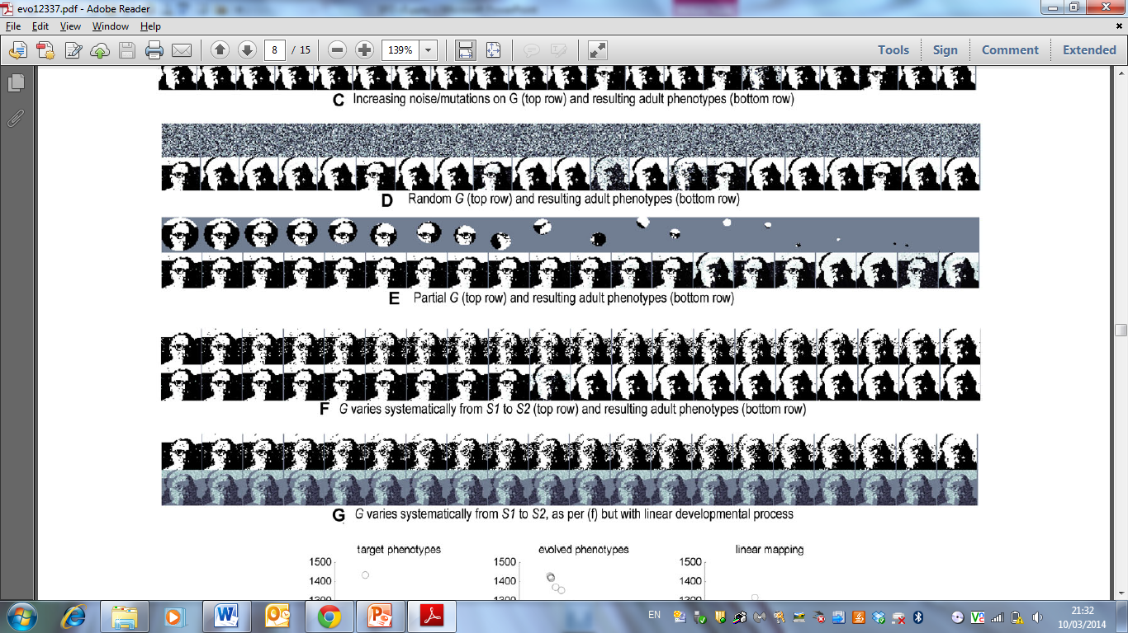
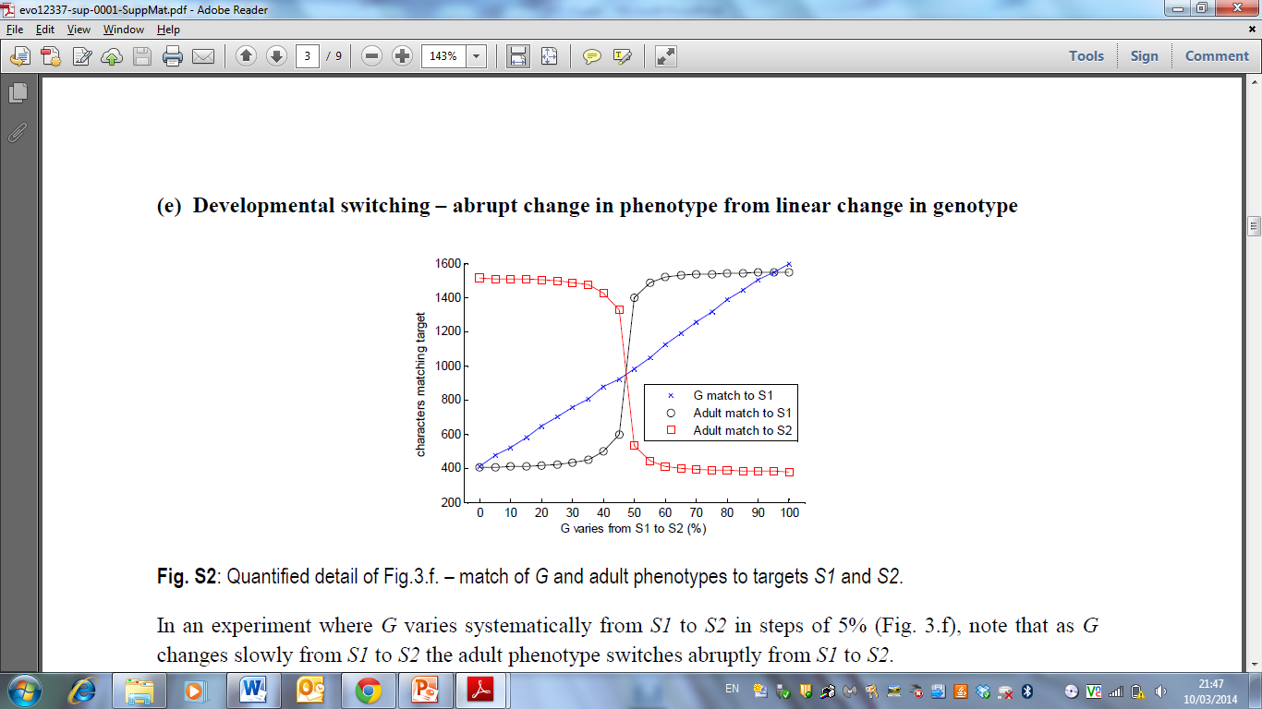
Linear change in embryonic phenotype
Produces highly non-linear change in adult phenotype
4. aka ‘recognition’ or ‘categorical perception’

Slide 57
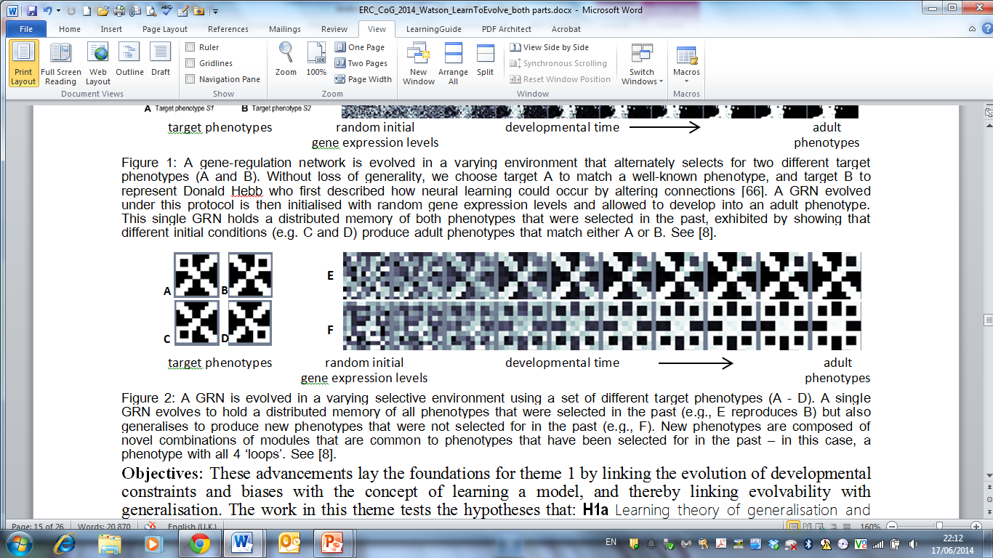
5. generalisation: Development can produce novel phenotypes that are new combinations of learned ‘features’

Slide 58
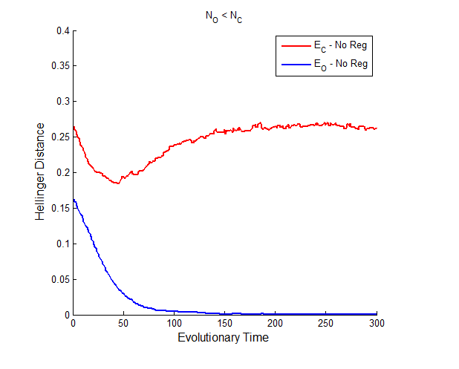
Improving fit to novel environments
Evolving in a random subset of selective environments drawn from a more general class
Kostas Kouvaris
But GRN doesnt produce phenotypes that are fit for the general class of selective environments
Distance between true class and set produced by the network
Easy to get perfect match to the set of selective environments you been evolved in

Slide 59
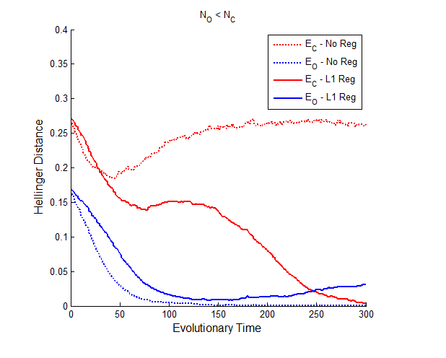
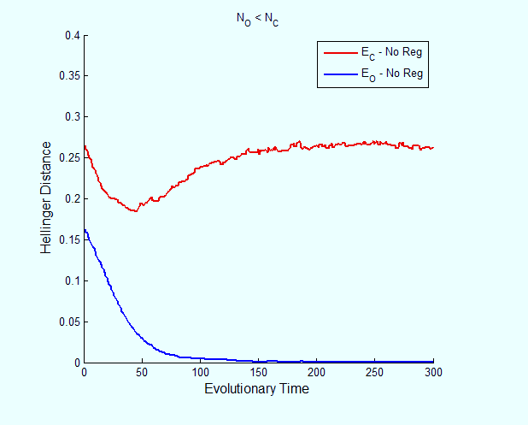
Improving fit to novel environments
Evolving in a random subset of selective environments drawn from a more general class
Kostas Kouvaris
Add selective pressure for sparse networks
Distance between true class and set produced by the network
Ability to cope with unseen environments improves dramatically
Fit to previously seen environments is slightly compromised

Slide 60
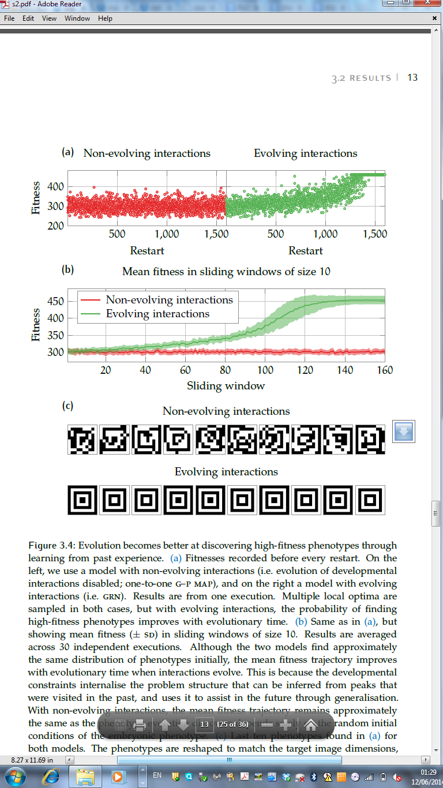
Example phenotypes evolved w and w/o evolved GP map
Example phenotypes evolved with evolved GP map
Fitnesses of locally optimal phenotypes found
Loizos Kounios
Deep evolutionary time (episodes)
Example phenotypes evolved with ~one-to-one GP map

Slide 61
